Slide 1
VTUNE Optimization
Optimizations using analysis of hotspots

Slide 2
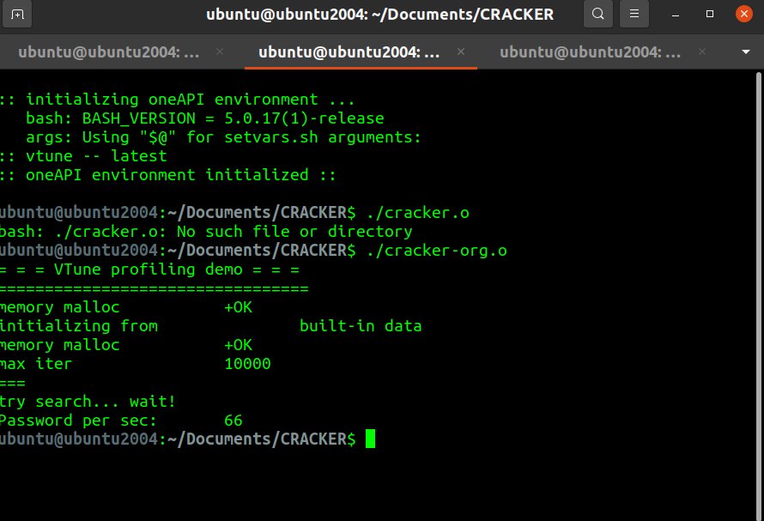
Runtime for original file

Slide 3
We got values around 60 for the original cracker.c without any optimizations.

Slide 4
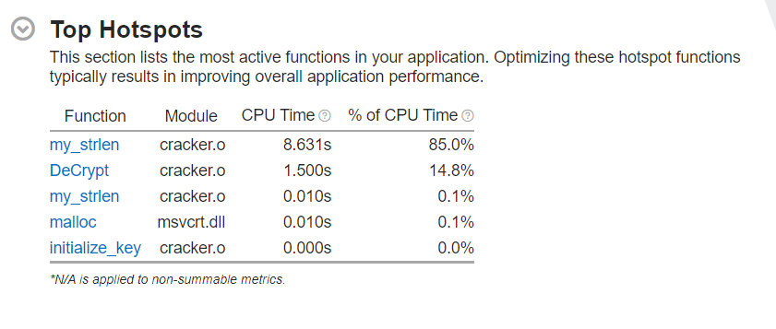
Using VTune

Slide 5
1. Minimising calls to my_strlen()
We minimised the number of calls of function my_strlen from 3 to 1 in DeCrypt() and from 2 to 1 in CheckCRC().
This resulted in the increase of password cracking rate from 60 to 3000s.

Slide 6
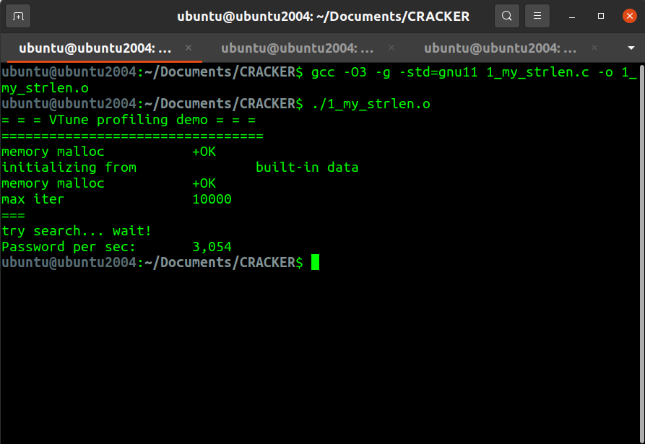
Reached upto 3000 !

Slide 7
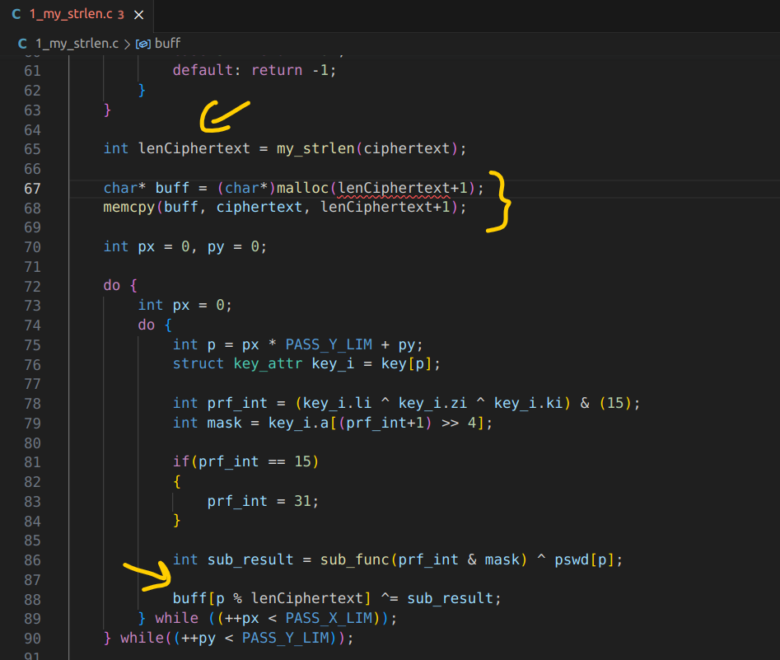
Changes in Decrypt()

Slide 8
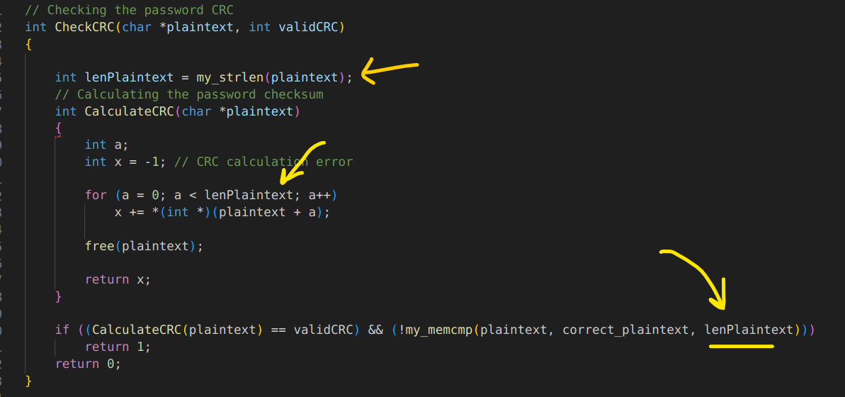
Inside CheckCRC()

Slide 9
2. Minimising calls to Decrypt()
Calls to Decrypt() function in do_pswd() are changed from 2 to 1.

Slide 10
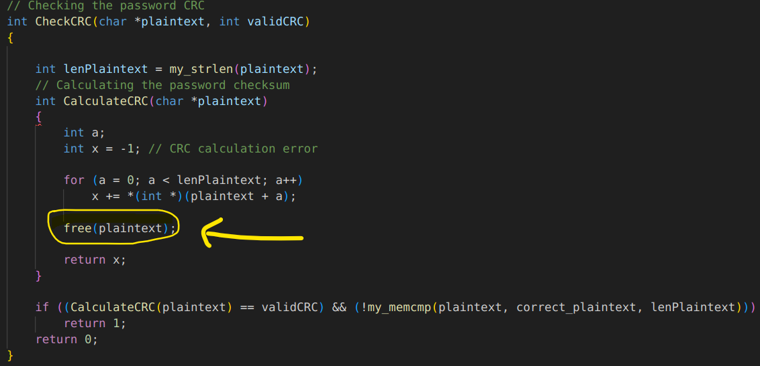
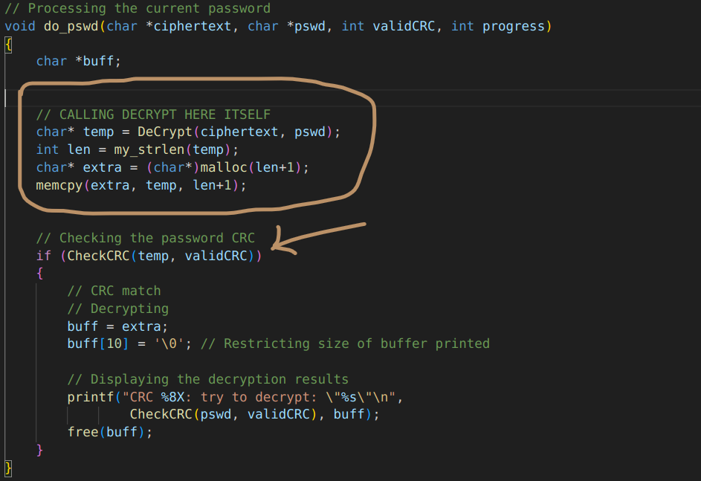

Slide 11
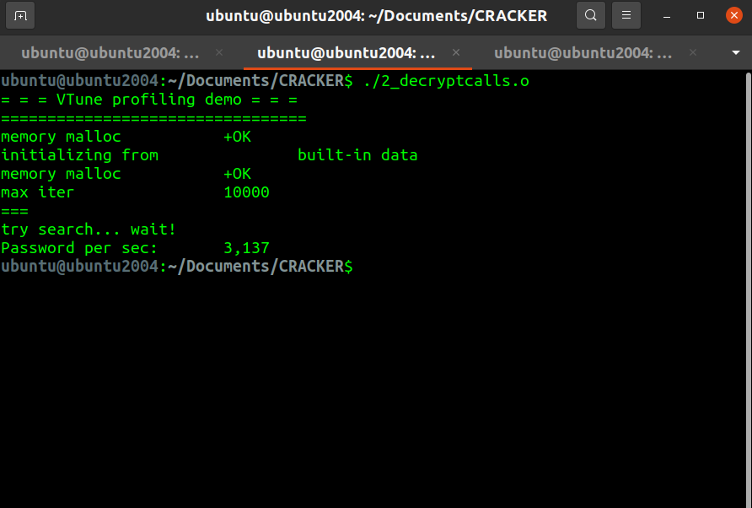
Gives a small increase ...

Slide 12
3. Two loops to one
In DeCrypt(), we replaced the doubly nested do-while loop by a single do-while loop.
Also, we calculated p % lenCyphertext more effectively using a variable pmod.

Slide 13
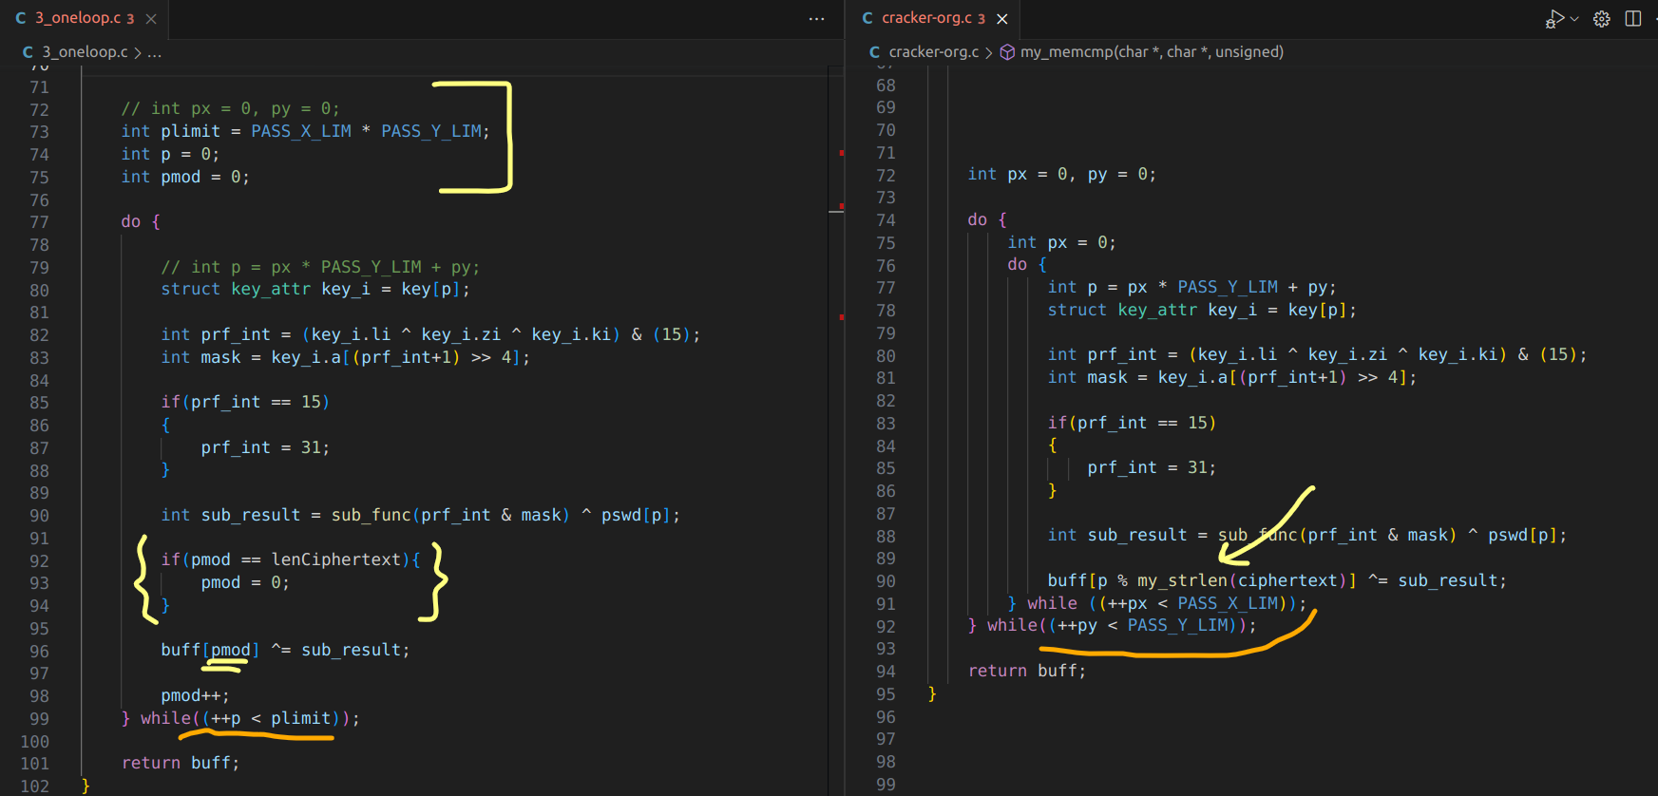

Slide 14
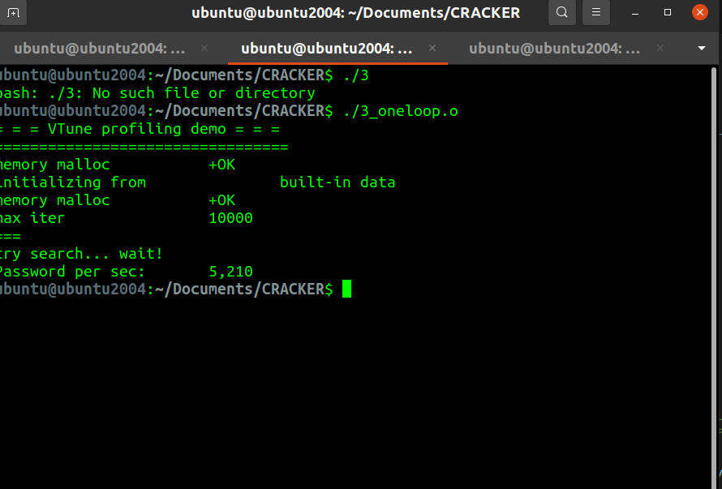
Tremendous increase!!!

Slide 15
4. Using constant values of char *a to reduce number of loads
We exploited the fact that value of char *a remains the same for all keys. Therefore it is not necessary to load it every time in the loop.
It can be calculated before the do-while loop.

Slide 16
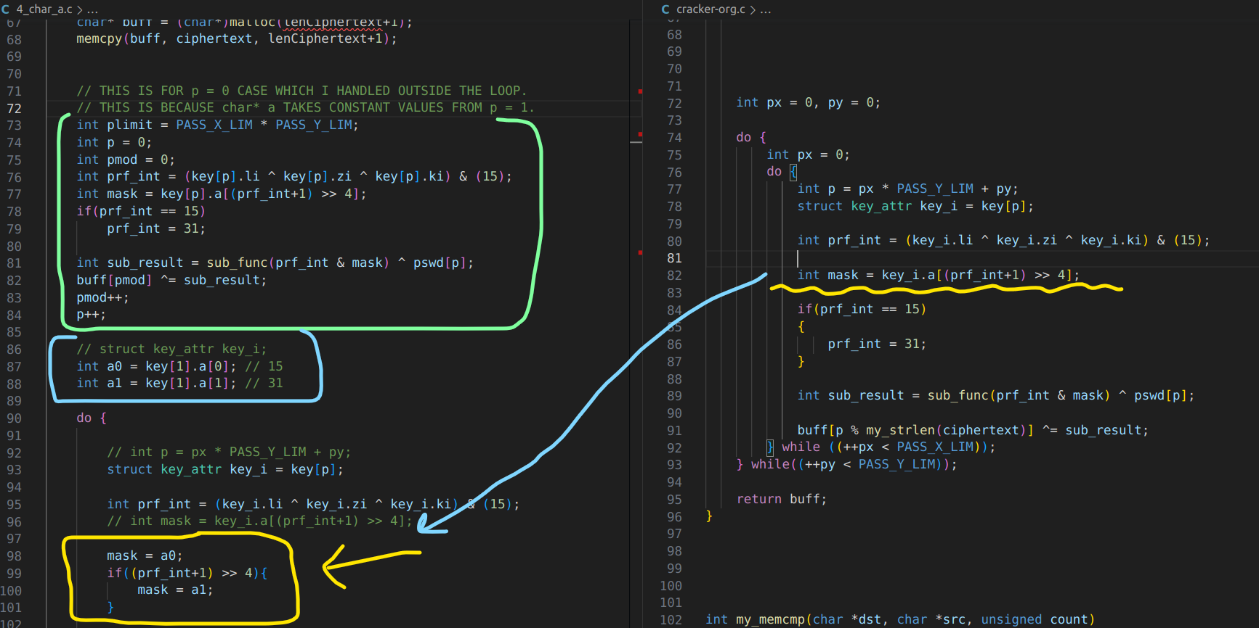

Slide 17
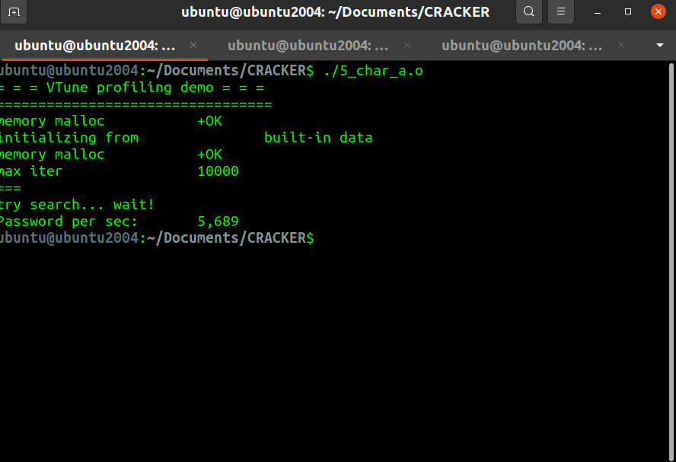
Getting there...

Slide 18
5. Removing key_i
Removed the instance of key_i by directly using key[p].
This can be done because key[p] is only being read.

Slide 19
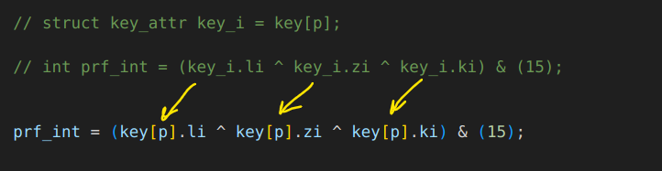

Slide 20
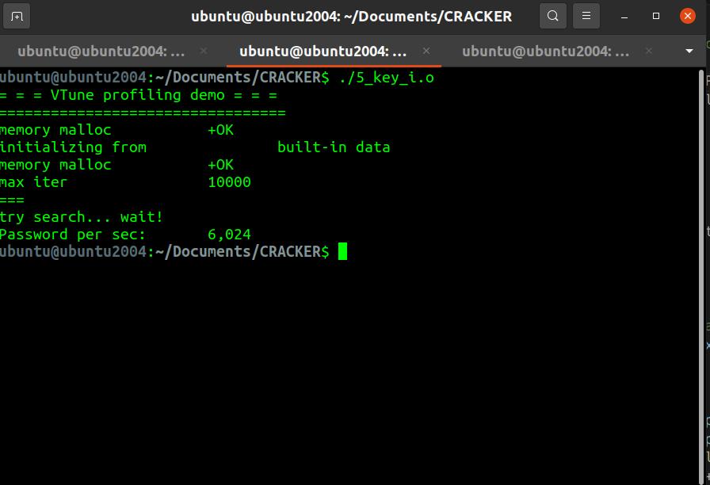
Finally, we cross the 6000 barrier

